Slide 1
Two-photon Imaging Using tunable Spatial Correlations
Juan Sebastian Vargas
Advisor: Dra. Alejandra Valencia

Slide 2
Outline
Imaging and Two-photon Imaging
Spatial Correlations
Experiment
Theory
Experimental Procedure
Theory vs. Experiment
Time Table

Slide 3
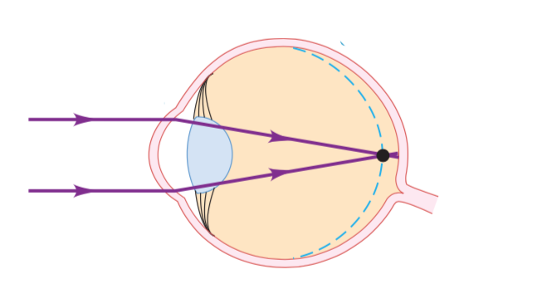
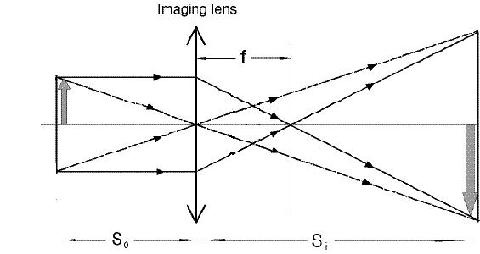
Imaging
Point-to-Point correspondence

Slide 4
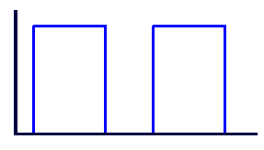



Two-Photon Imaging
D₂
S.C
X₂
X₂
D₁
C.C
X₂
S.C
X₂
Notes:
por que podemos recuperar la imagen? es necesario introducir la nocion de correlacion espacial

Slide 5
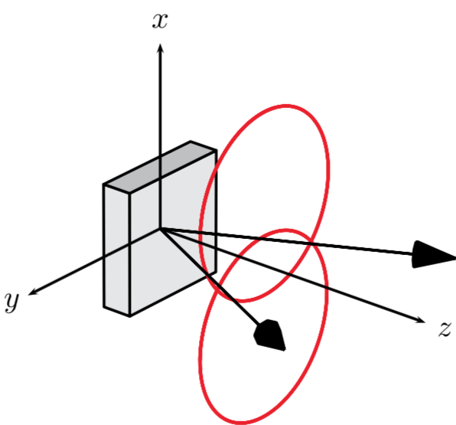
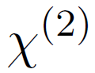
Spatial Correlations
SPDC
(spontaneous parametric down conversion)
Signal
Pump
Idler
Notes:
generacion de pares cuyas posiciones estan relacionadas entre si, es decir, para un x1 dado existen unos x2 con mayor probabilidad.

Slide 6
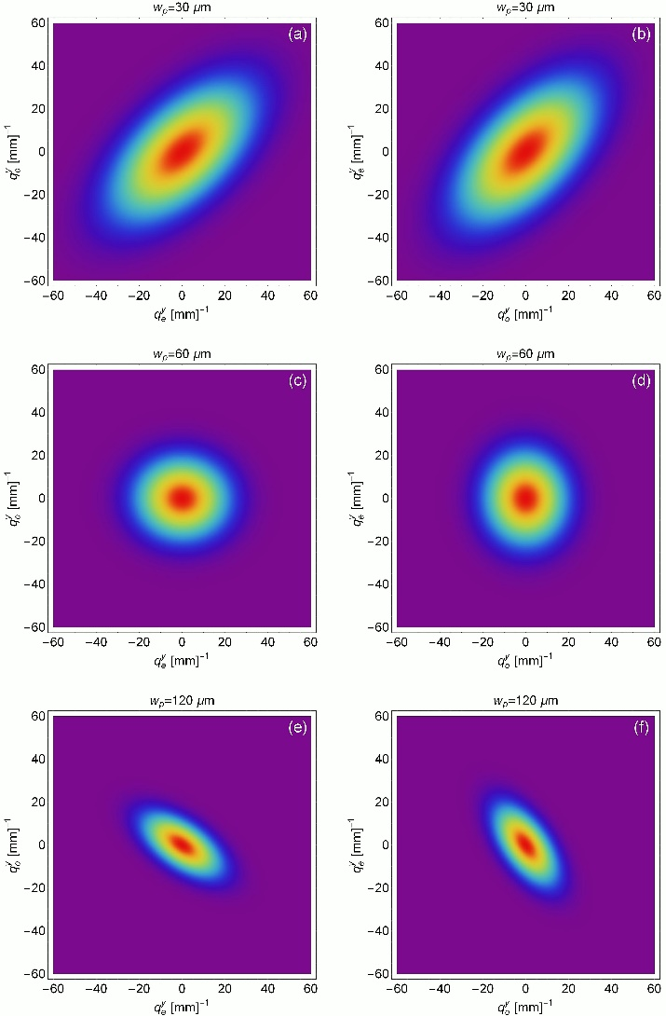
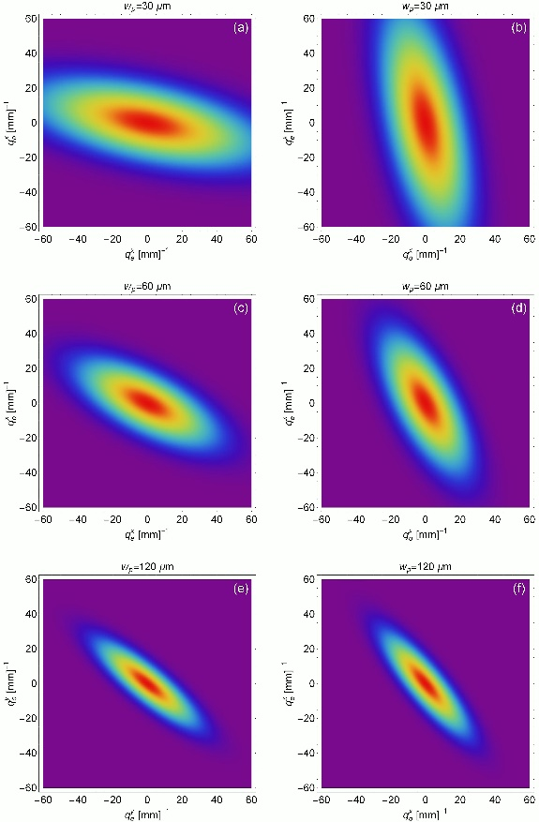
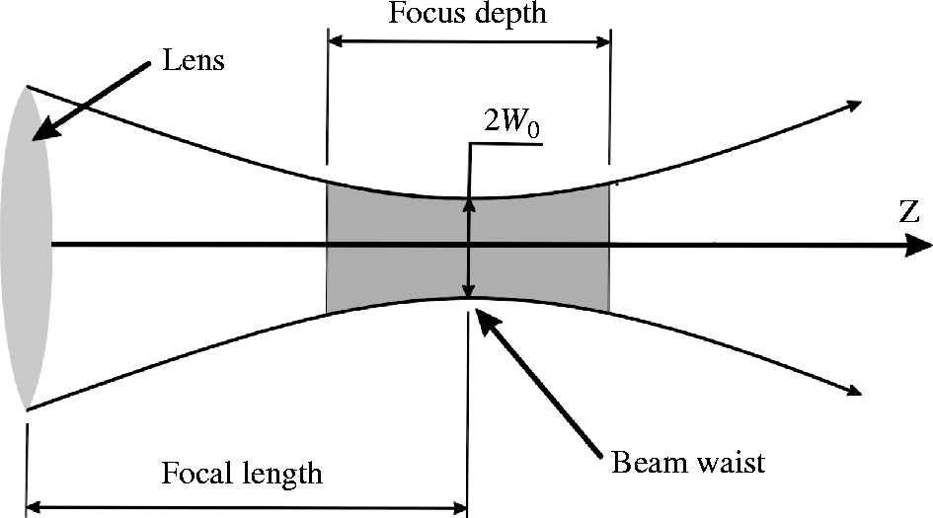
Tunable Spatial Correlations
SPDC
(spontaneous parametric down conversion)
x-direction
y-direction
Pump
Signal
Idler
Notes:
como medimos estas correlaciones?

Slide 7
Experimental Setup for Correlations
Notes:
Experimental setup for obtaining the spatial correlations

Slide 8
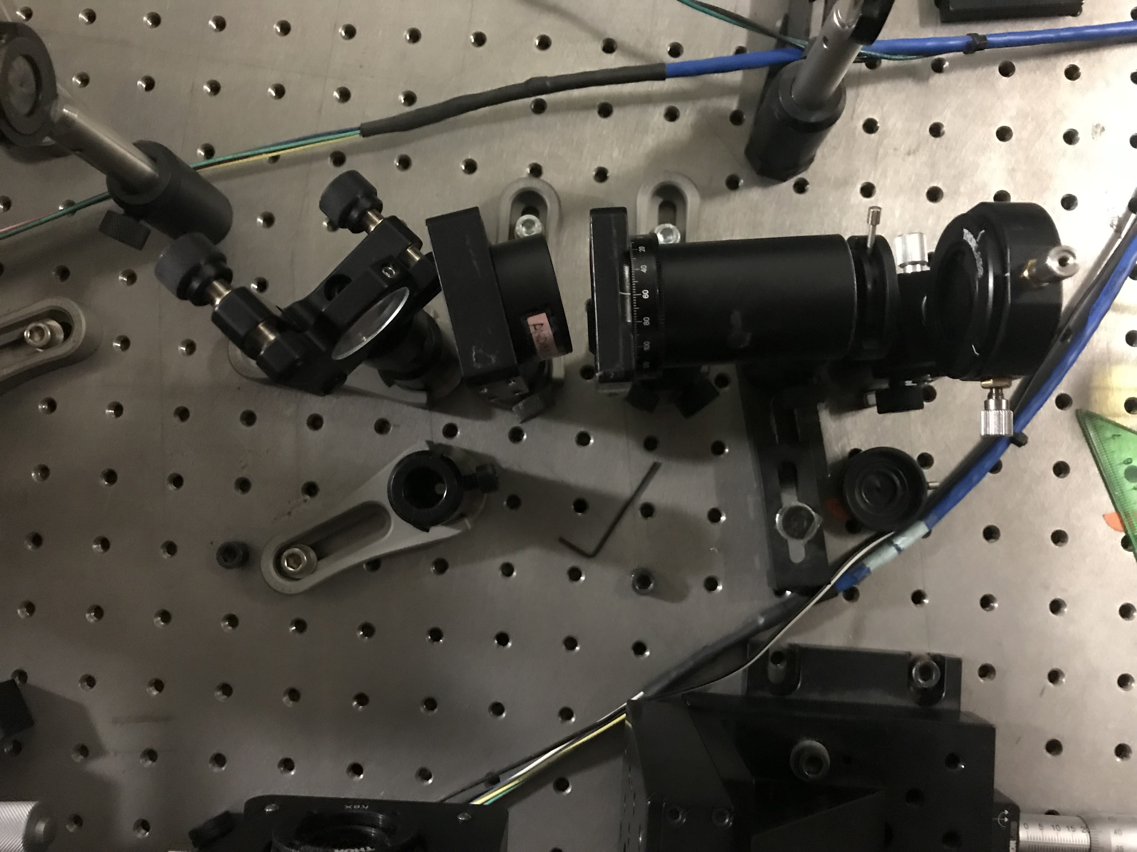
Experiment
Notes:
Debo ser capas de ver el ghost y ver las correlaciones !!!!

Slide 9

Theory
Notes:
Setup del Ghost , titulo imagenes

Slide 10
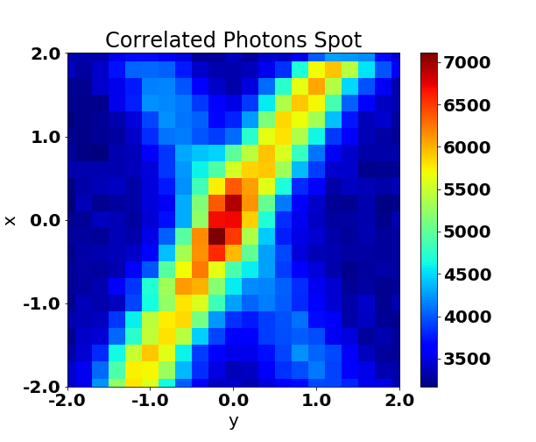
Experimental Procedure 1.Finding the correlated photons

Slide 11
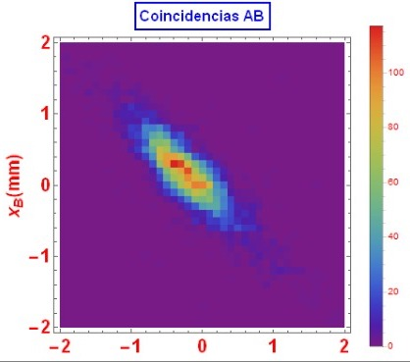
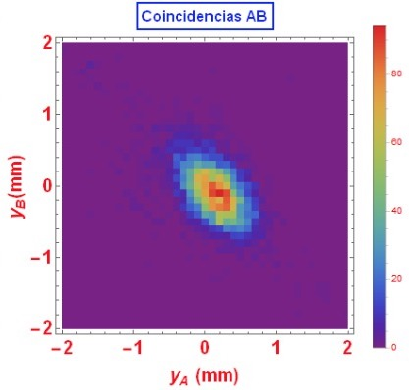
Experimental Procedure 2. Measuring Spatial Correlations
Notes:
Referencias imagenes de el grupo. Diciendolo.

Slide 12

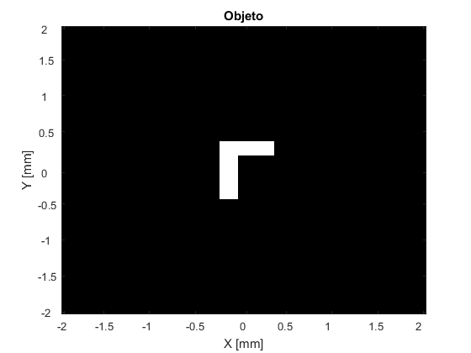
Experimental Procedure 3. Mask Alignment: Used Masks

Slide 13
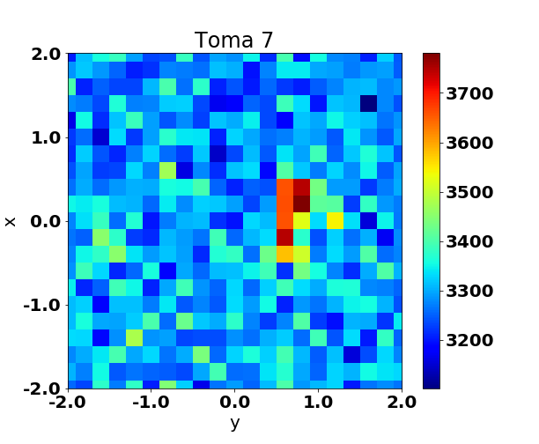
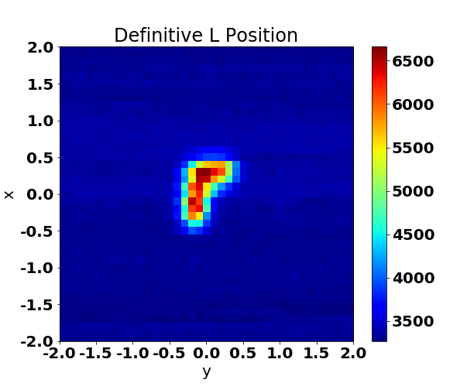
Experimental Procedure 3. Mask Alignment

Slide 14
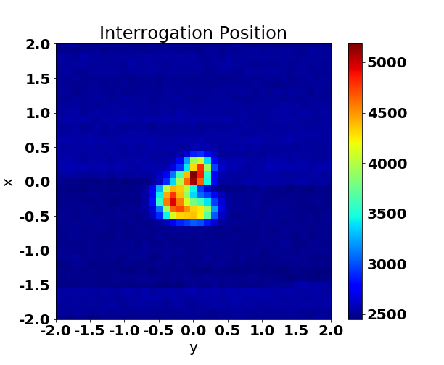
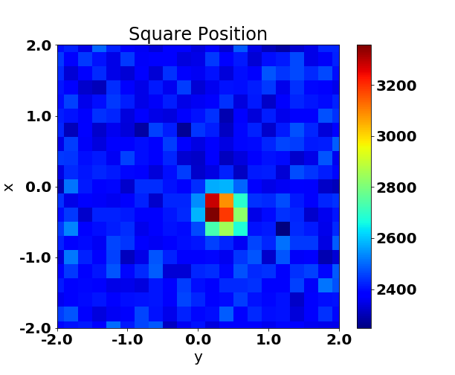
Experimental Procedure 3. Mask Alignment

Slide 15
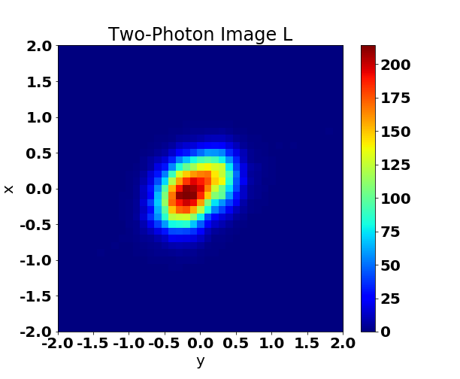
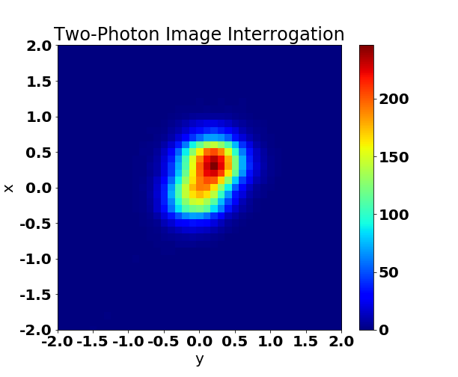
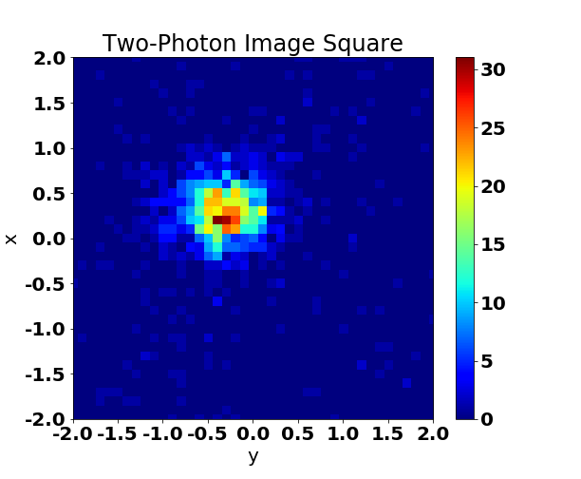
Experimental Procedure 4. Two-photon Imaging
Notes:
EJES CON MAYOR INFORMACION, SIZE, UNIDADES. Ghost_Inter.png
Ghost_L.png

Slide 16
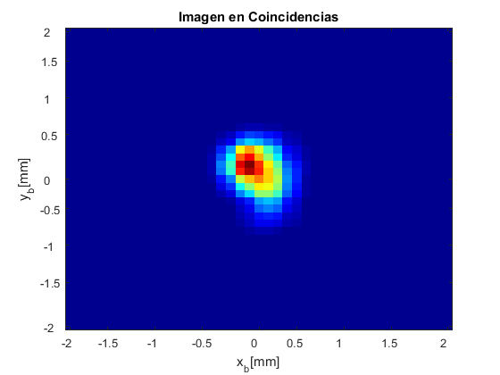
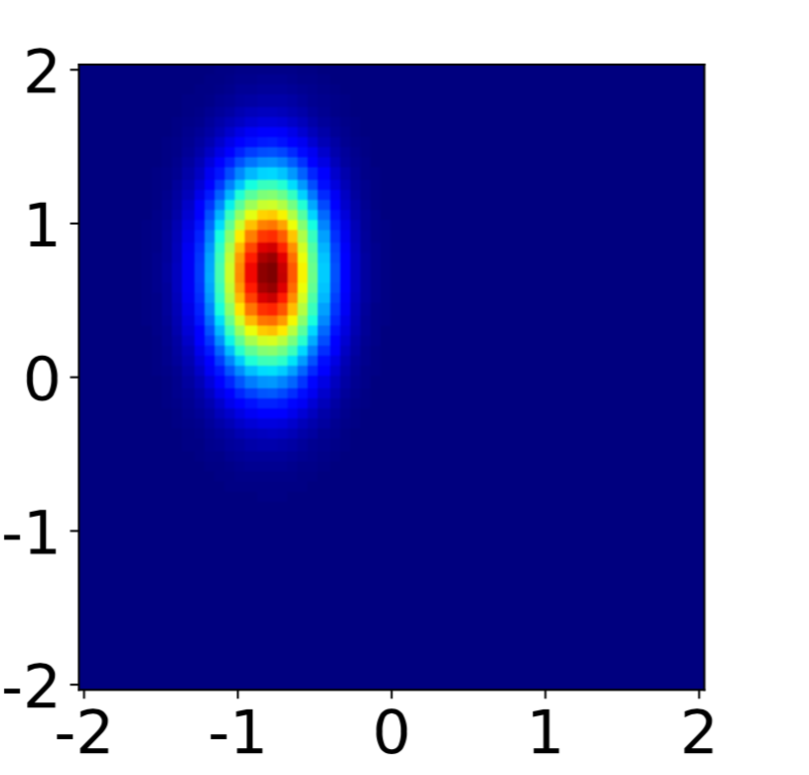
Theory vs. Experiment

Slide 17
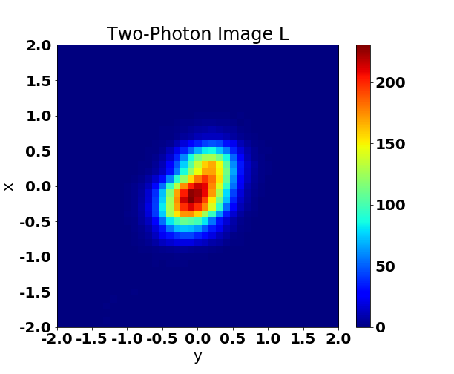
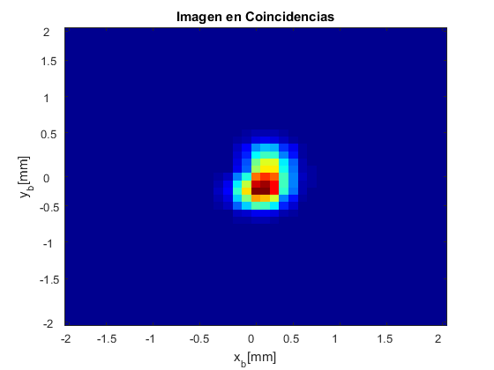
Theory vs. Experiment

Slide 18
Time Table
 | 1 | 2 | 3 | 4 | 5 | 6 | 7 | 8 | 9 | 10 | 11 | 12 | 13 | 14 | 15 | 16
T1 | X | X | X |  |  |  |  |  | X |  |  |  |  | X
T2 |  | X | X
T3 |  |  | X | X
T4 |  |  |  | X | X
T5 |  |  |  |  | X | X
T6 |  |  |  |  |  | X | X
T7 |  |  |  |  |  |  | X | X | X
T8 |  |  |  |  |  |  |  |  | X | X |  | X | X
T9 |  |  |  |  |  |  |  |  |  | X | X |  |  | X
T10 |  |  |  |  | X |  |  |  | X |  |  |  |  |  | X | X
T11 |  |  |  |  |  |  |  | X
T12 |  |  |  |  |  | X |  |  |  | X
Theoretical and Practical
Bibliography Review
Laboratory Equipment
Writing First version, Theoretical Aspects
SPDC Source
4. Understanding SPDC process
5. Learning how to control the waist pump
Measuring Different Spatial Correlations
Lens less Two-photon Imaging
7. Experimental Setup
Data Acquisition and Analysis
Data Acquisition
Data Analysis
Document and Presentations
10. Document writing
11. 30% presentation
12. Quantum Optics Seminar presentation

Slide 19
Future Work
Change pump waist
Measure new correlations
Two-photon Imaging with the used masks
Compare Results

